Slide 1



Analysis on Enrollment Data
Submitted by: Sumit Kashyap
Submitted to: Xiwei Chen

Slide 2
Data Description:
Following Data consist of enrollment of students in University every quarter from fall 2013 till fall, 2016
Data Dictionary:
Course name-> Name of the course
Course Identification -> Id of given course
CRN-> Course record number (Unique)
PriortoFall16 -> taught before fall 2016 or not
No Grade-> Incomplete scorer
Withroworfailgrades-> Failed student or couldn’t complete
Passing grade-> Passed student

Slide 3
Purpose of Analysis
Define business question
Bring meaningful insights from the data
Predict any pattern

Slide 4

Steps in Analysis
Data Gathering
Cleaning the data
Performing analysis
Representing in visual format
Conveying finding
Using insights for further implementation and improvement

Slide 5
Business Question:
What is the trend of Student taking admission? What courses are mostly preferred by students?

Slide 6
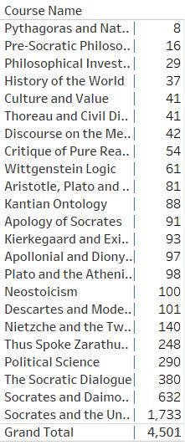
Analysis
Out of 4,501 students from fall, 2013 till fall, 2016 students have preferred taking admission in Socrates and the Unexamined Life which is also three times of 2nd highest preferred course.
Pythagoras and Natural Philosophy have the least enrolment during the period
Zarathustra, Political Science, The Socratic Dialogue and Socrates and Dialogue comes under one cluster
All other course are not that popular

Slide 7
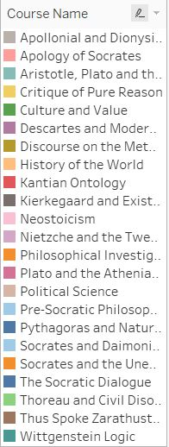
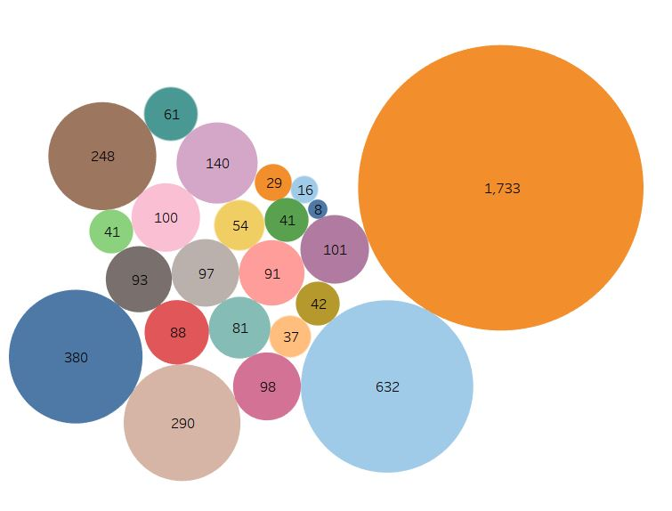
Visual Analysis

Slide 8
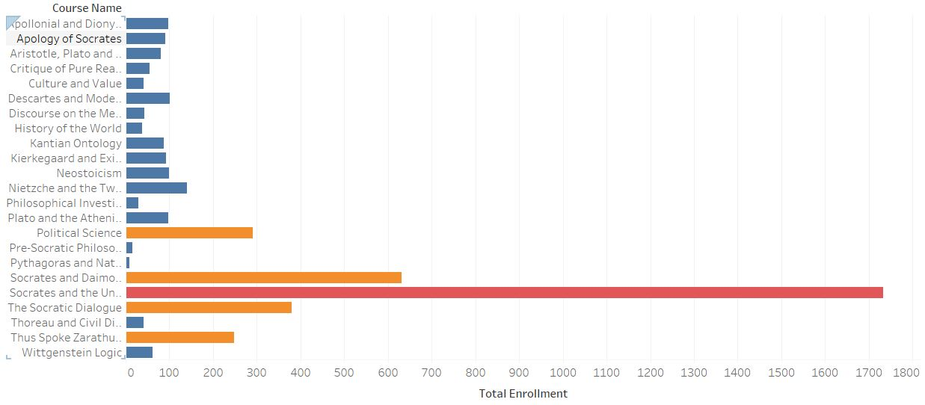
Visual Analysis: Clustering of data into 3 Groups
While performing analysis I found 3 different clusters of courses:

Slide 9
Reason for such stats
Demand of such skills in the market makes student to pursue Socrates and the Unexamined Life. (not enough data to confirm that reason)
Faculty or the course curriculum is best among all other universities. Makes student to join this course.
Its online as well as offline classes makes it flexible for students to pursue.
Note:- These are all assumption, there is not enough data to confirm the following reason.

Slide 10
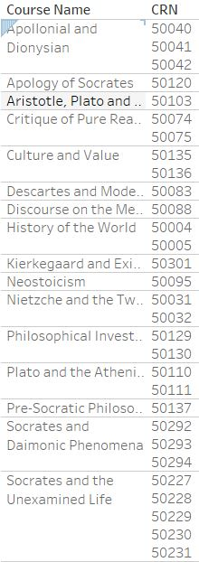
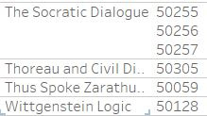
Analysis:2 Priority fall CRN
Following are the CRN with the courses prior to fall :
36/305 are the only courses
Kantian Ontology, political Science, Pythagoras and Natural Philosophy, Socrates and Daimonic Phenomena are the only curses who are not Prior to Fall,16

Slide 11
ANALYSIS 3: Enrolment trend
Looking at the enrolment trend, Students mostly prefer taking admissions in fall with least in summer. Fall 2016 semester did show improvement over past years.
For the following year there has not been much change despite of increasing the number of classes every year. Looking at the trend, there is no need of additional classes then what university have.

Slide 12
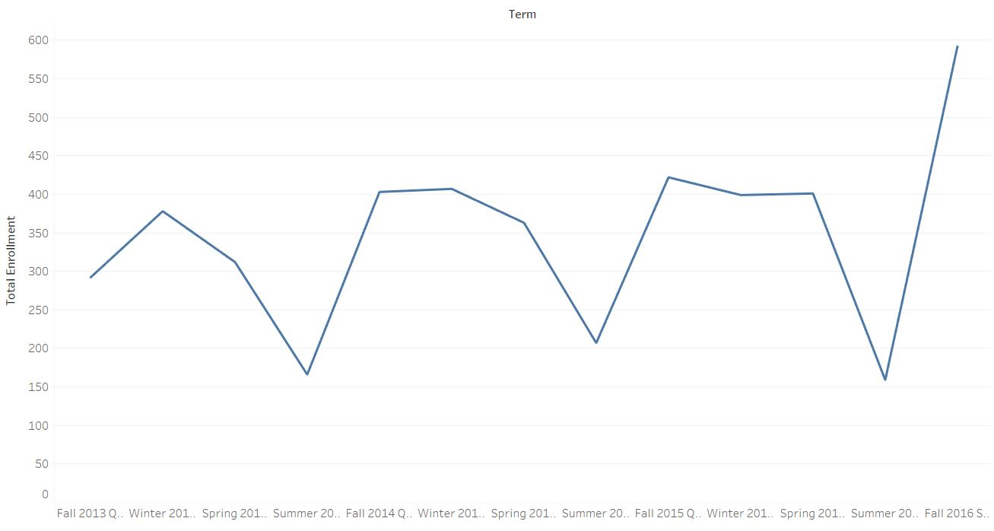
Visual ANALAYSIS
Summer season have least admission where as fall have maximum

Slide 13
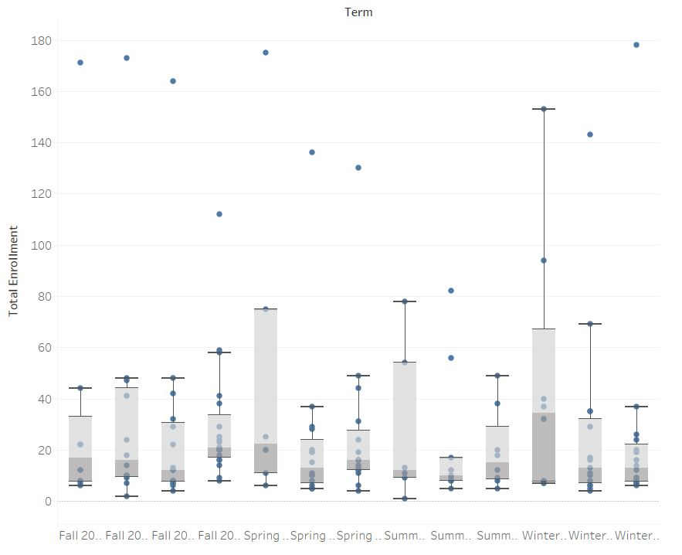
Analysis 4: Outliers in data
Outliers belongs to Socrates and the Unexamined, This is a deal breaker courses. More class should be introduced to meet the demand or new courses aligned to this should be launched to attract more students.

Slide 14
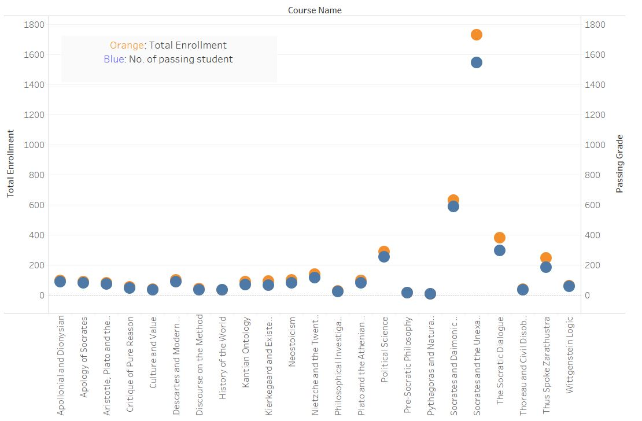
Analysis 5: How many students are passing
There are more failures in courses which are in demand comparison to less demanding courses.
Larger data sometimes shoes bigger variation, it is hard to say there is less failure in other courses as not enough data is present to know that.
Still considering the failure, university needs to find easier alternative courses for the student who cannot handle its curriculum.

Slide 15
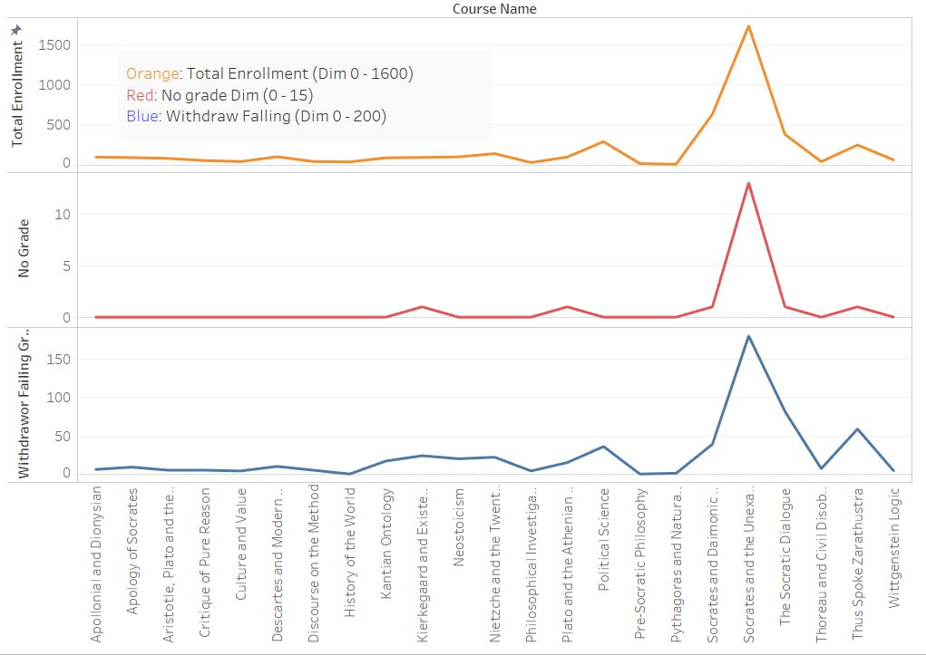
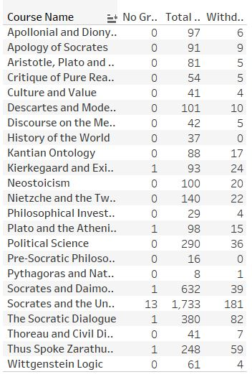
Analysis 5: Continued
Here variation corresponds to in demand courses: more students tends to fail in Socrates and the Unexamined then other courses But that percentage is a fraction of total.

Slide 16
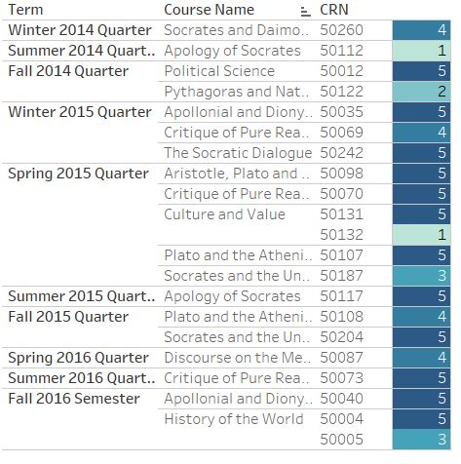
Courses should be considered stopped teaching
I took out come classes which showed lowest enrolment, out of which Apology of Socrates, Pythagoras and Natural Philosophy should not be considered continuing in future.

Slide 17

Thank You

